Slide 1

MAHARASHTRA STATE BOARD OF TECHNICAL EDUCATION Certificate
This is to certify that Mr. SUFYAAN MALADWALLA , HUSSAIN ARSIWALA , ABDURRAHMAN QURESHI , MORE ARYA LAXMAN. Roll No. 210441 , 210448 , 210451 , 210460 of 1ST Semester of Diploma in COMPUTER ENGINEERING of Institute M. H. SABOO SIDDIK POLYTECHNIC (Code: 0002) has completed the term work satisfactorily in course PHYSICS for the academic year 2021 to 2022 as prescribed in the curriculum.
Place: MUMBAI Enrolment No: 2100020104 , 2100020112 , 2100020102 , 2100020097 , 2100020117
Date: Exam. Seat No:

Slide 2
Roll no. | Student Name | Marks out of 6 for performance in group activity | Marks out of 4 for performance in oral/ presentation | TOTAL MARKS OUT OF 10
210441 | SUFYAAN MALADWALLA
210448 | HUSSAIN ARSIWALA
210451 | ABDURRAHMAN QURESHI
210460 | MORE ARYA LAXMAN
NAME & SIGNATURE OF FACULTY:

Slide 3
Physics micro-project
Guided by NIMRAH ANSARI

Slide 4
PARTICIPANTS: ROLL NO: 210441 NAME: SUFIYAAN MALADWALA ROLL NO: 210448 NAME: HUSSAIN ARSIWALA ROLL NO: 210451 NAME: ABDURRAHMAN QURESHI ROLL NO: 210460 NAME: MORE ARYA LAXMAN
BRANCH: COMPUTER ENGINEERING SEMESTER: FIRST

Slide 5
Good and bad conductors

Slide 6
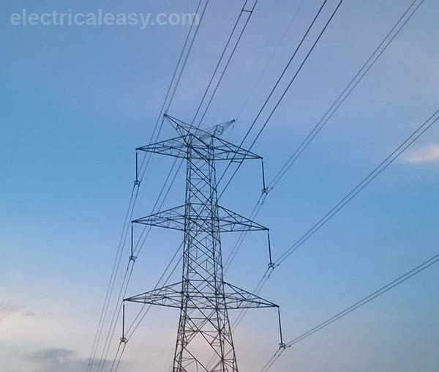
WHAT ARE CONDUCTORS?
An electrical conductor is a substance in which electrical charge carriers, usually electrons, move easily from atom to atom with the application of voltage. Conductivity, in general, is the capacity to transmit something, such as electricity or heat.

Slide 7
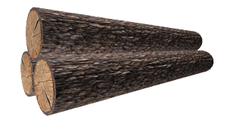
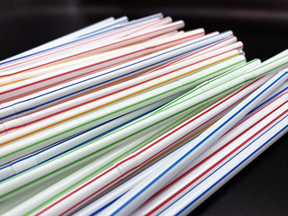
BAD CONDUCTORS
Some of the worst conductors of electricity include rubber, polymer and plastic. A bad electrical conductor is an object or material that does not allow electricity to flow freely through it. An insulator does not allow electric current to pass through it. Most metals, such as copper, are good conductors, whereas most other non-metal materials are bad conductors, or insulators.

Slide 8
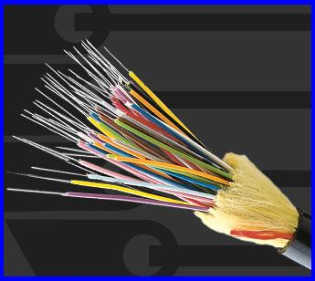
PROPERTIES OF BAD CONDUCTORS
Used for making wires for
Used for making wires for the transmission of electrical energy. The transmission of electrical energy.
Resistivity is very low.
Conducts heat and electricity.

Slide 9
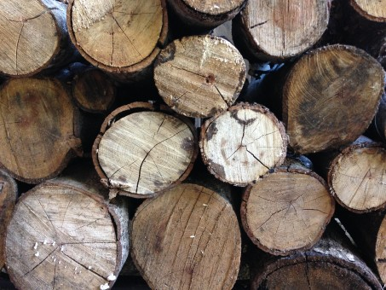
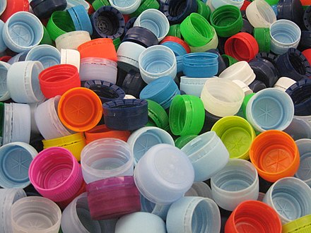
USE OF BAD CONDUTORS
All components like transformer, inductor, capacitor or any device has to use insulation for their working as also for safety.
Safety of equipment, materials , personnel or user from circuit voltage, or high voltage is only possible by proper usage of insulation
Bad conductor is a term used for poor conductors, or insulation materials. They are called bad conductors, because there is no perfect insulator which can totally block current, so as not to allow even an iota of current.

Slide 10
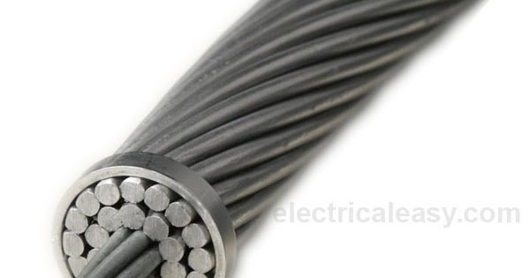
GOOD CONDUCTORS
Materials that allow heat to pass through them easily are called good conductors of heat. Metals like copper and aluminum have the highest thermal conductivity while steel and bronze have the lowest. As copper is an excellent conductor of heat, it is good for heat exchanger also. Gold, Silver, Iron etc. are also some examples of good heat conductors as well as electrical conductors.

Slide 11
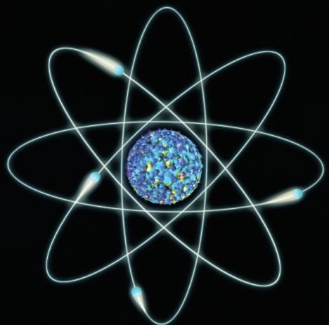
PROPERTIES OF GOOD CONDUCTORS
A conductor always allows the movement of electrons and ions in them.
The electric field of a conductor is zero allowing electrons to flow within them.
The charge density of a conductor is zero.
Only on the surface of the conductor, free charges exist.
All points of a conductor are at the same potential.

Slide 12
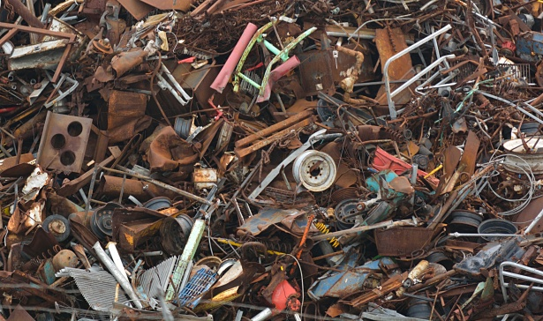
USE OF GOOD CONDUTORS
Coils of conductor form inductor or transformers.
Coils of conductors around cores make electromagnets.
Used in generator to produce electricity.
Ferromagnetic materials and alloys like steel are used for transformers , motors, generators and electromagnet cores.

Slide 13
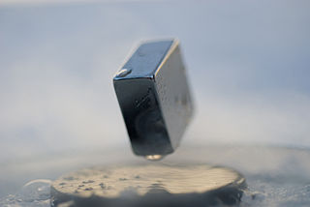
SUPERCONDUCTORS
The superconductor is a material that offers no resistance to the flow of electrons and conducts electricity. The superconductivity phenomenon was discovered by Heike Kamerlingh Onnes, the Dutch Physicist in 1911. Superconductors are elements or metallic alloy, when cooled below a certain threshold temperature, lose electrical resistance property and become superconductors.
Some of the best superconductors are niobium, cuprite, magnesium and digoride.

Slide 14
THANK YOU

